Slide 1
How much carbon is enough? Sufficiency in a global perspective
consumption-based
Julia K. Steinberger J. Timmons Roberts & Glen Peters
Joint CCCEP/UKERC workshop
Imperial College, London, July 5th 2011

Slide 2
Outline
0. Policy relevance?
Sufficient carbon: past & future
Consumption perspective

Slide 3
Problems and solutions
Starting point: environmental problems exist.
They can be measured – quantification.
They have causes – phenomena in human societies.
They can be allocated: to industrial processes, economic sectors, population groups, geographic regions, production, consumption ...
The “solutions” we propose to environmental problems will depend on how we measure them, understand their causes, and allocate responsibility.

Slide 4
Evidence-based decision making
David Shrigley

Slide 5
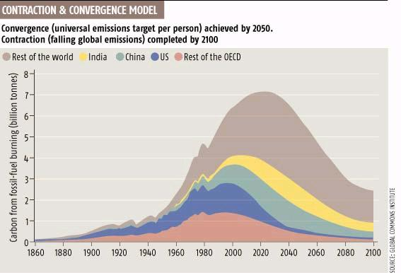
The challenge: a low-carbon future
Contraction & convergence of global emissions
2007 | tC/cap
USA | 5.2
UK | 2.41
China | 1.35
Brazil | 0.52
India | 0.39
Nigeria | 0.18
2005
1.2 tC/cap
2050
0.6 tC/cap
Population growth
(or as low as 0.2 tC/cap by 2100)

Slide 6
Sufficiency: how much CO₂ is necessary for a good life?

Slide 7
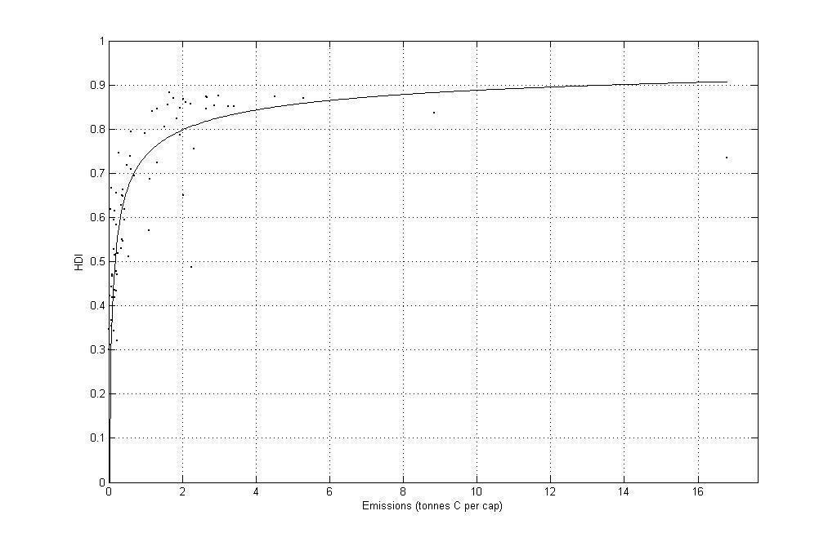
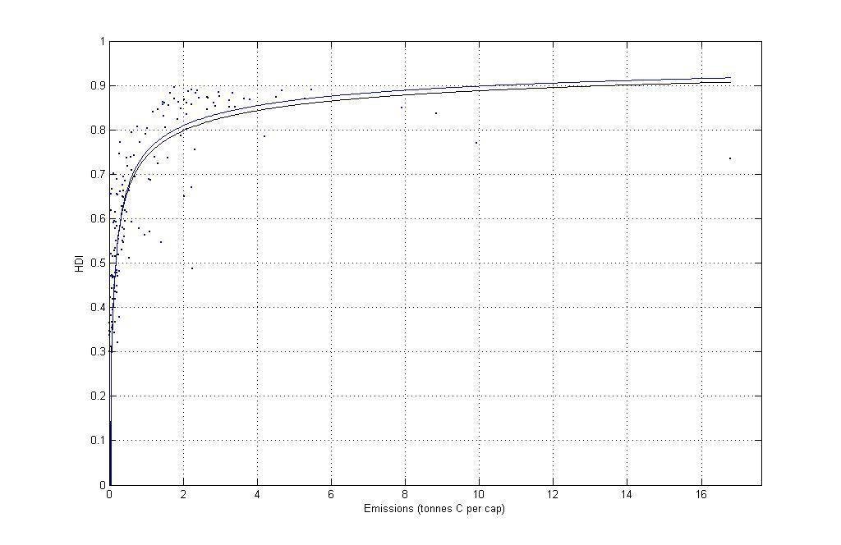
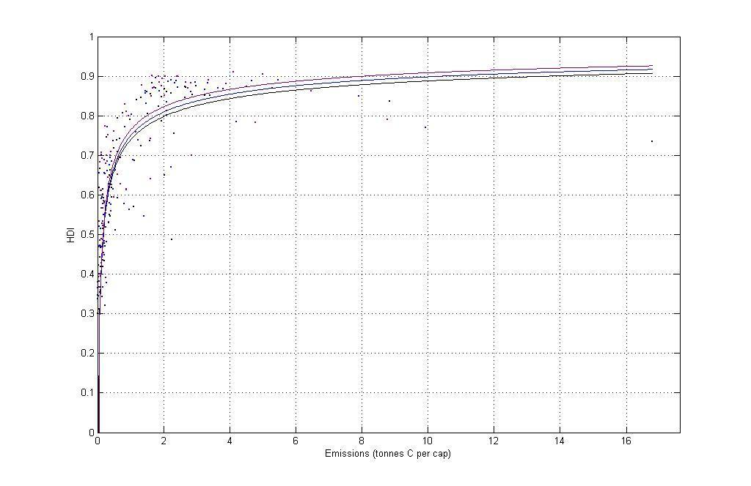
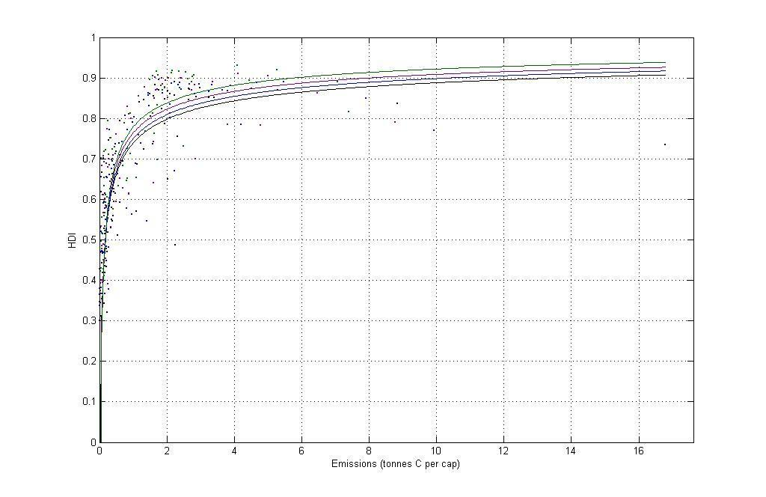
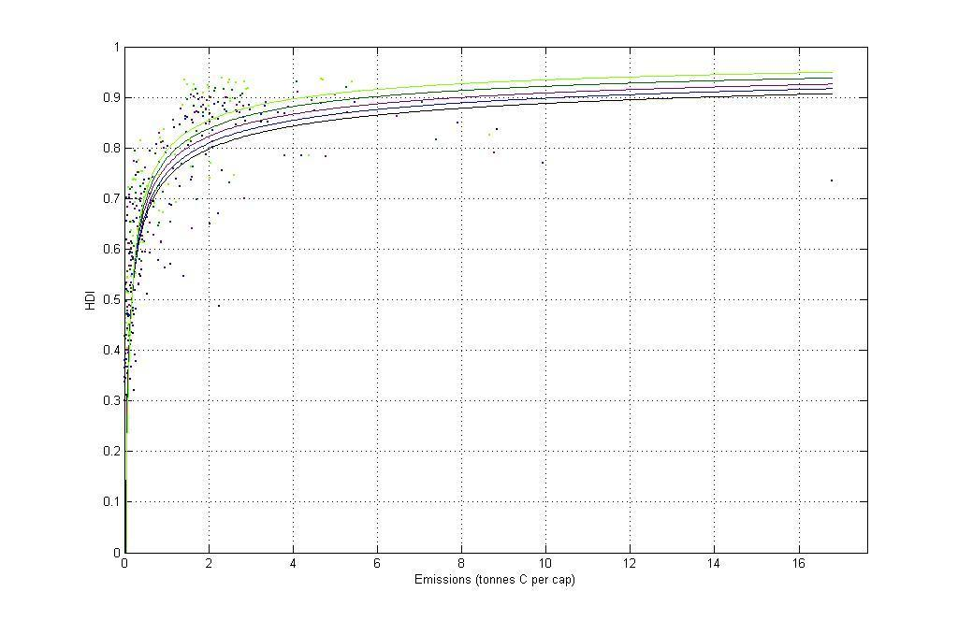
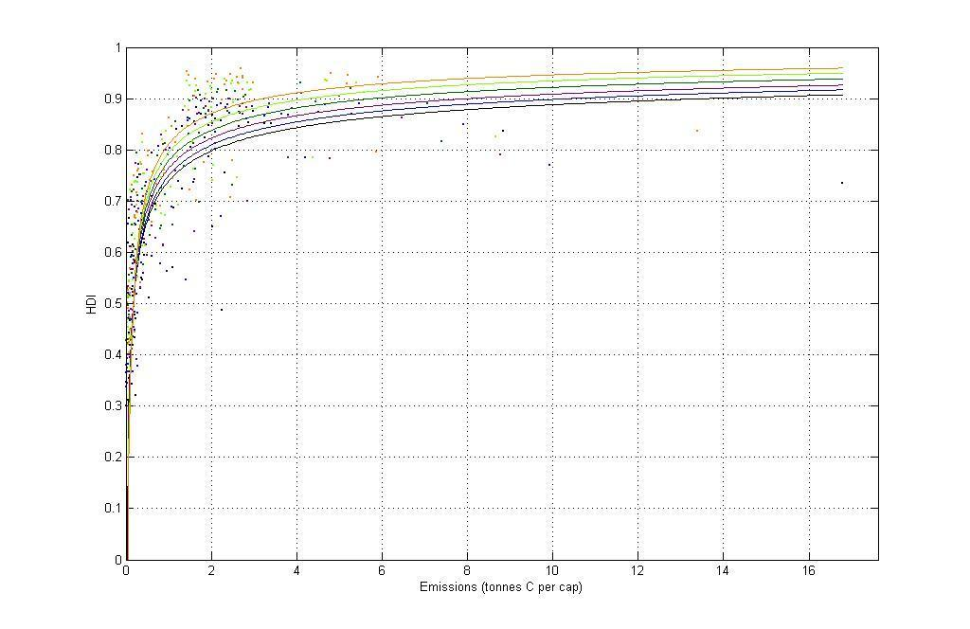
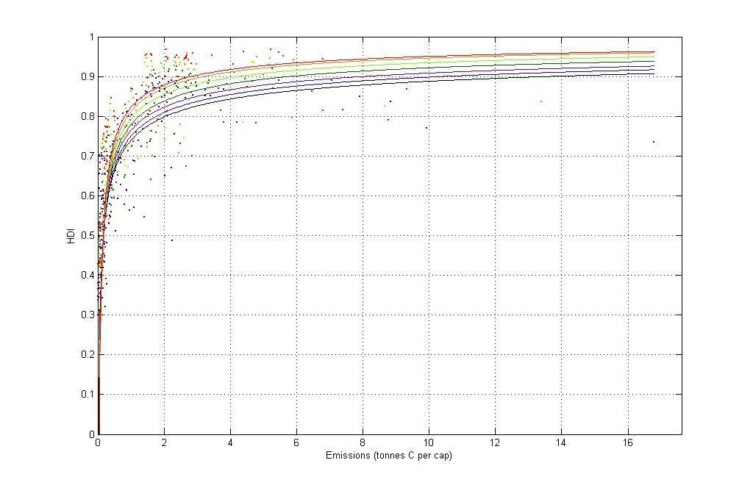
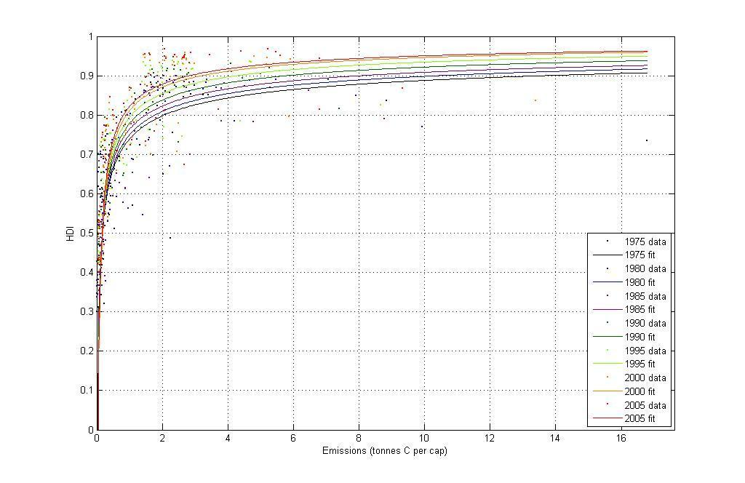
Human Development vs. Carbon
High human development requires less and less carbon!
2005
2000
Human Development Index
1995
1990
1985
1980
1975
Carbon emissions (tC/cap)
Steinberger & Roberts 2010

Slide 8
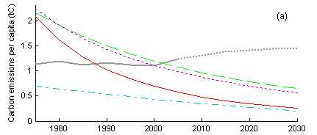
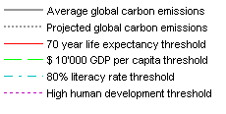
Carbon “thresholds” for sufficiency
0.6 tC/cap
C&C 2050 level
Steinberger & Roberts 2010

Slide 9
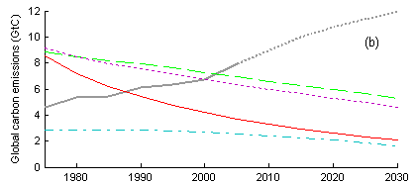
Global carbon “thresholds”
5.5GtC
C&C 2050 level
Steinberger & Roberts 2010

Slide 10
consumption-based
How much CO₂ is necessary for a good life?

Slide 11
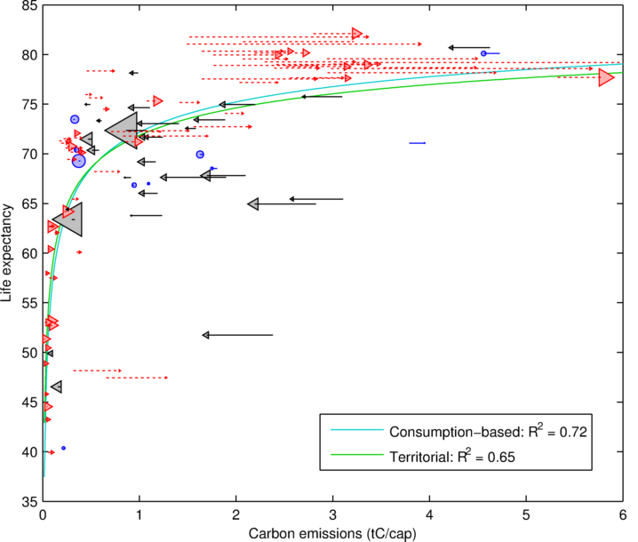
Sufficiency and carbon emissions: Taking trade into account
Carbon importer
Carbon exporter
Carbon neutral
Life expectancy (years)
Steinberger, Roberts & Peters 2011
CO2 emissions: R² = 0.65
Corrected for trade: R² = 0.72
Carbon emissions (tonnes carbon per capita)

Slide 12
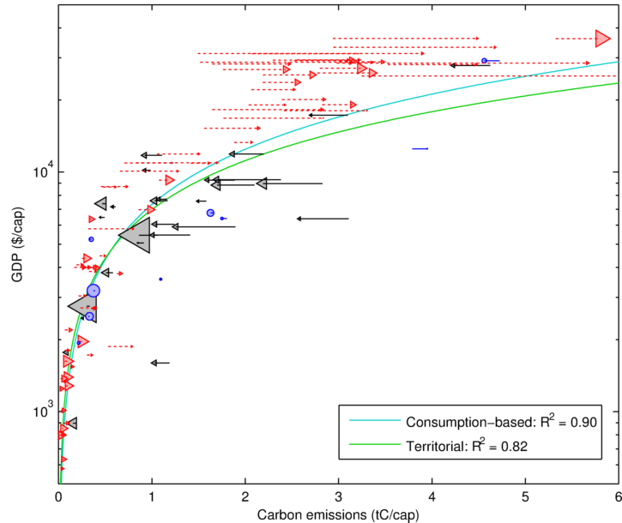
Income and carbon emissions: Taking trade into account
Carbon importer
Carbon exporter
Carbon neutral
GDP ($ per capita)
Steinberger, Roberts & Peters 2011
CO2 emissions: R² = 0.82
Corrected for trade: R² = 0.90
Carbon emissions (tonnes carbon per capita)

Slide 13
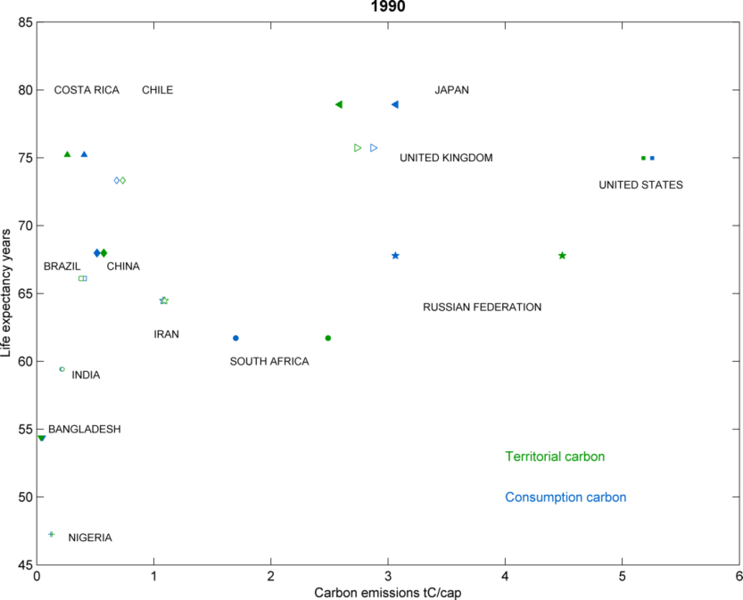
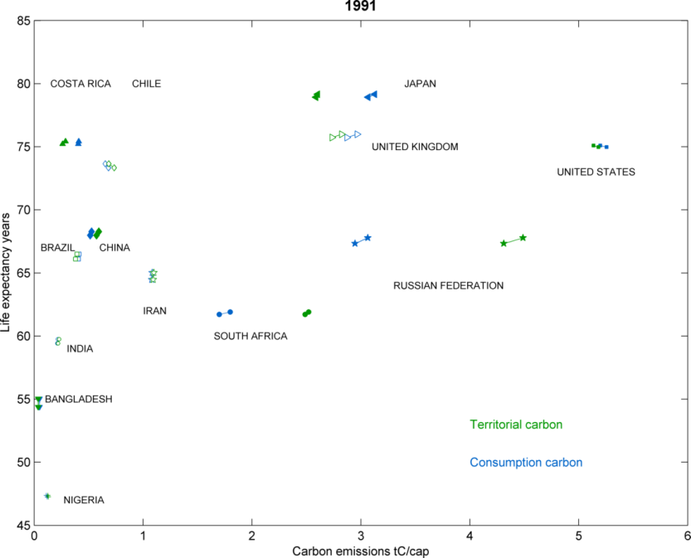
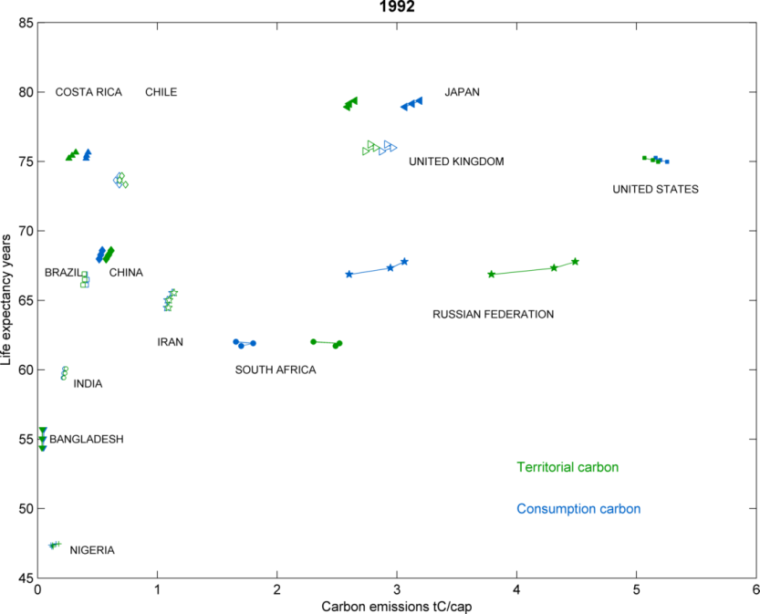
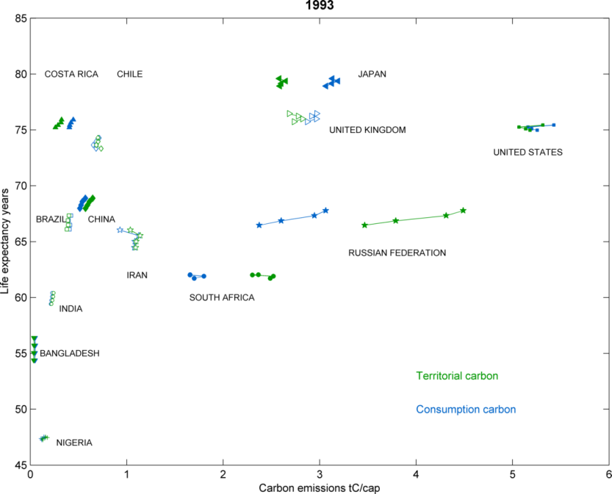
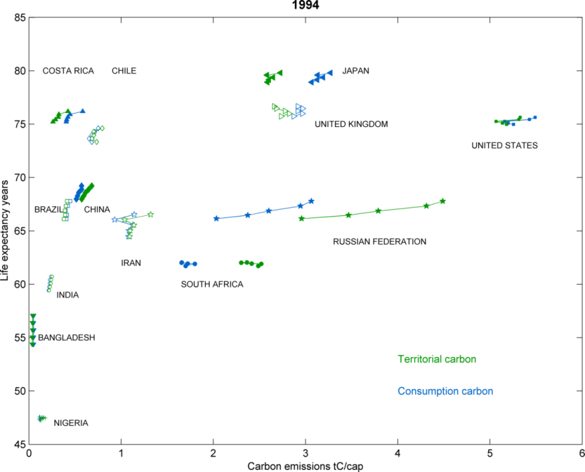
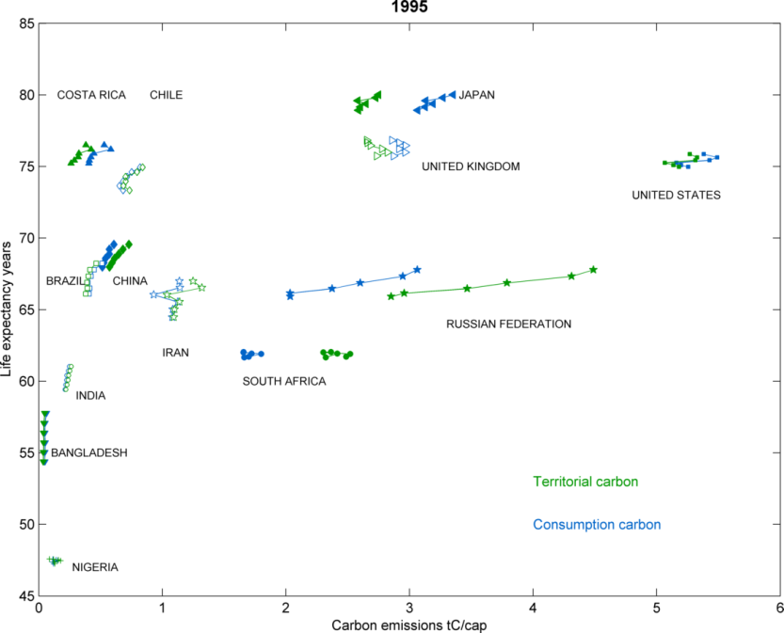
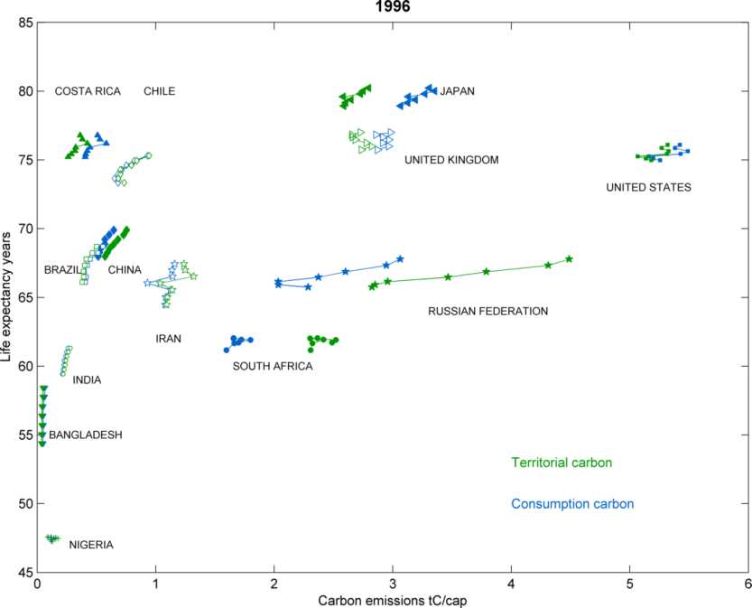
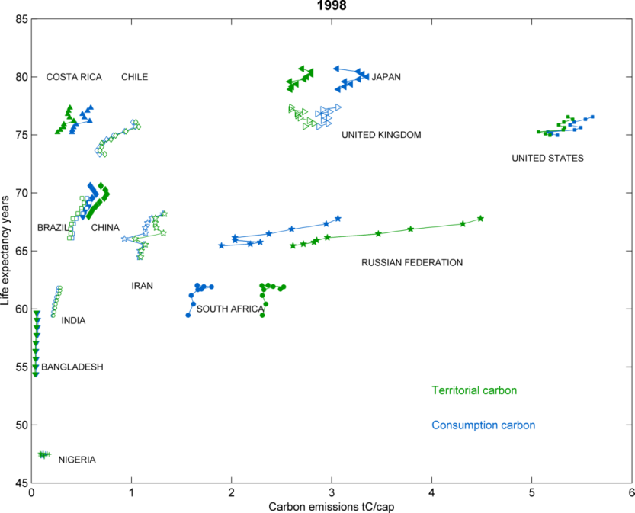
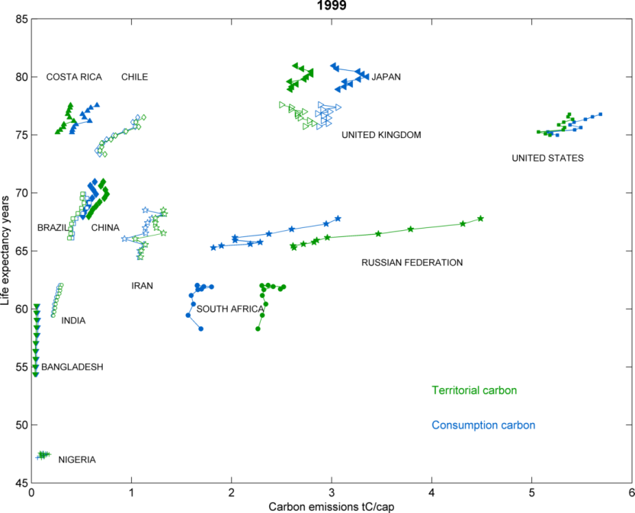
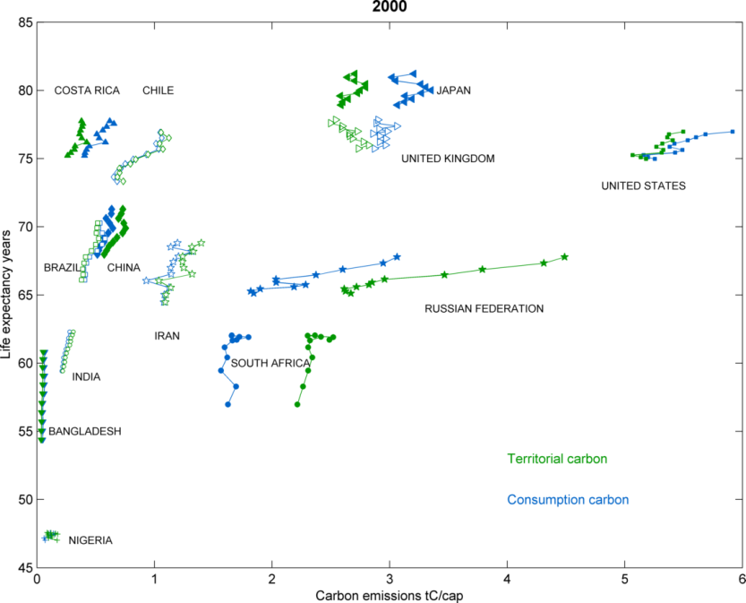
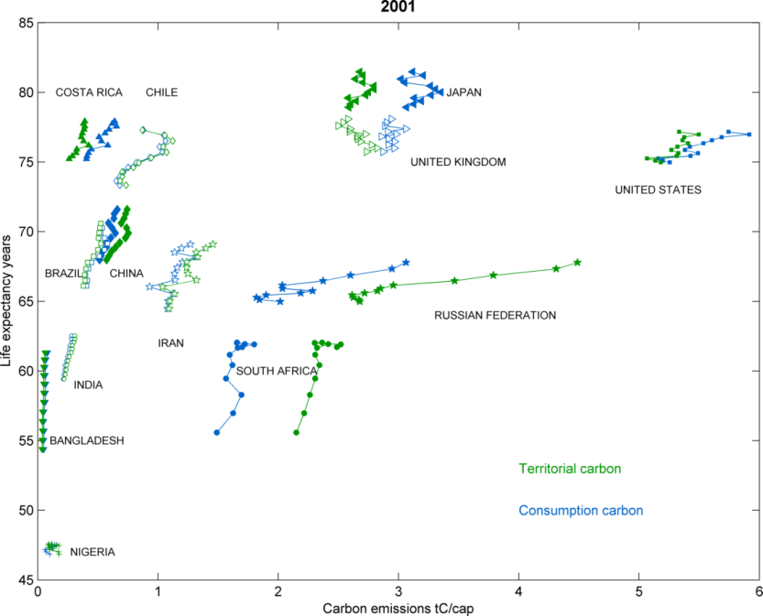
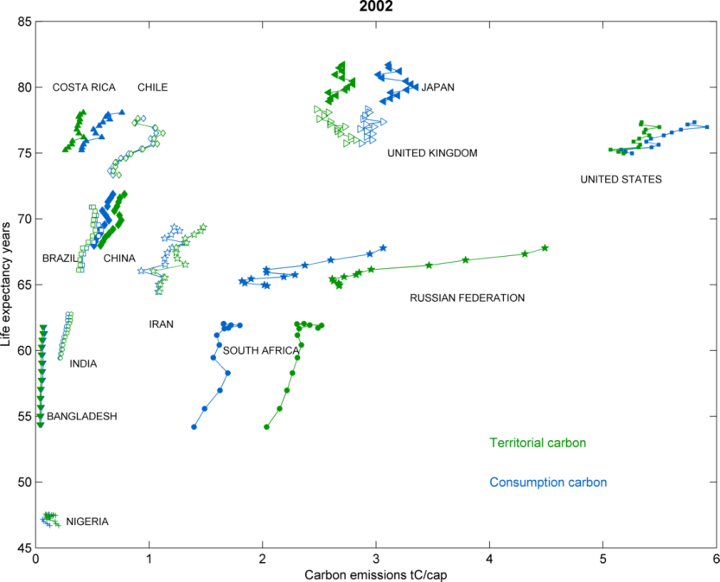
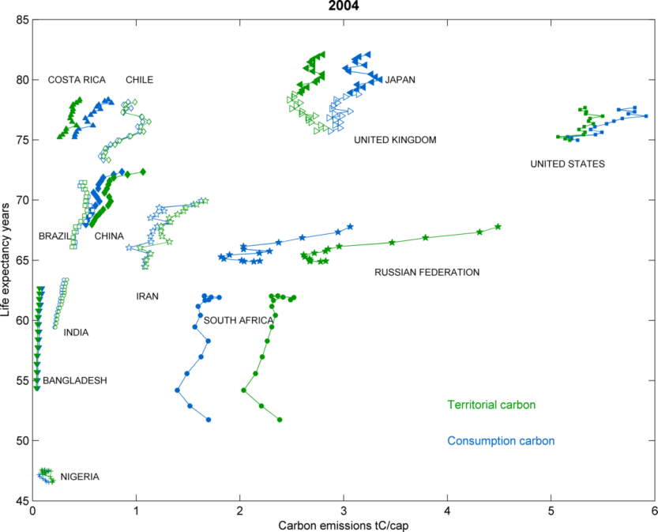
Life expectancy (years)
Territorial emissions CO₂
Consumption-based CO₂
Carbon emissions (tonnes carbon per capita)

Slide 14
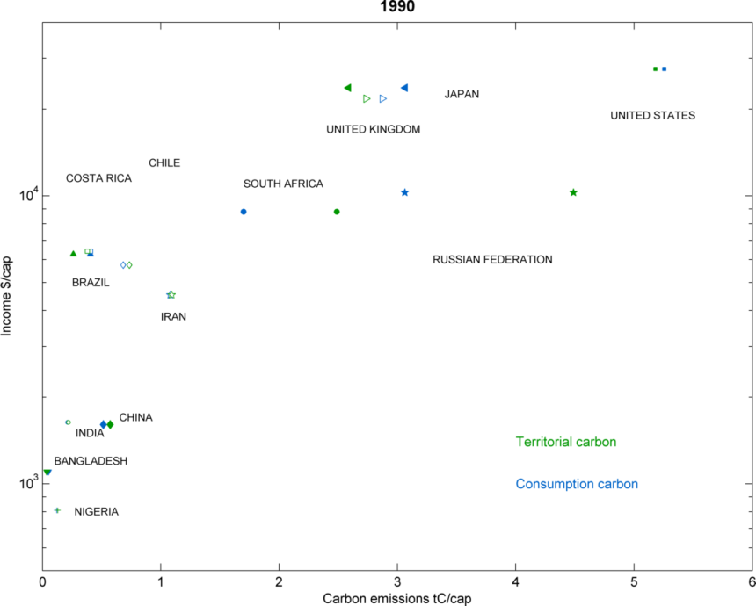
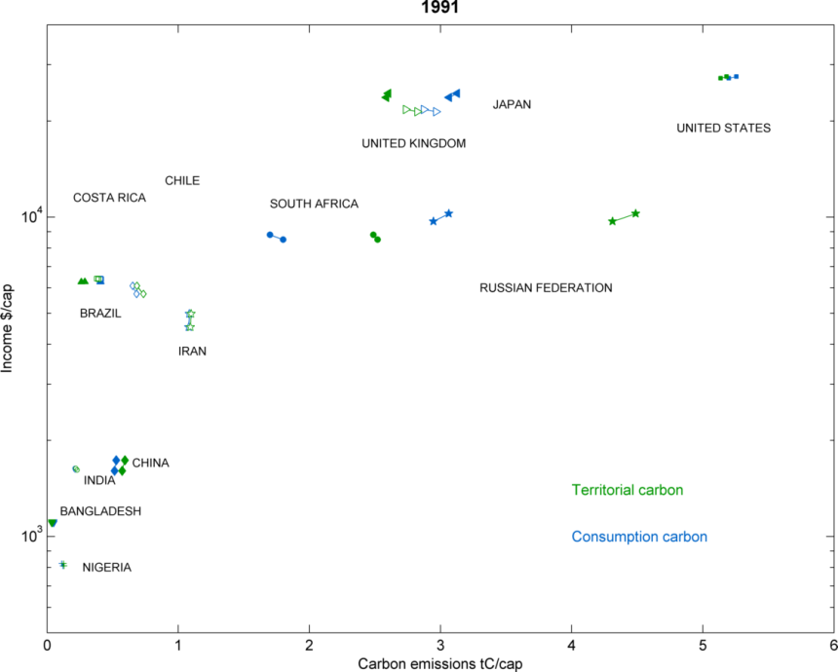
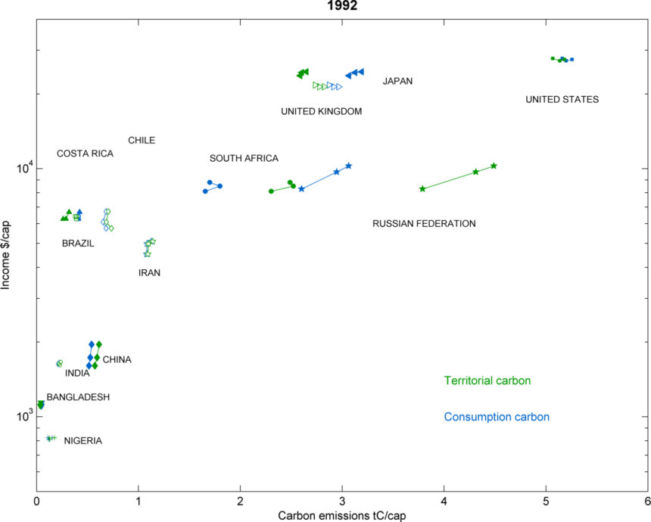
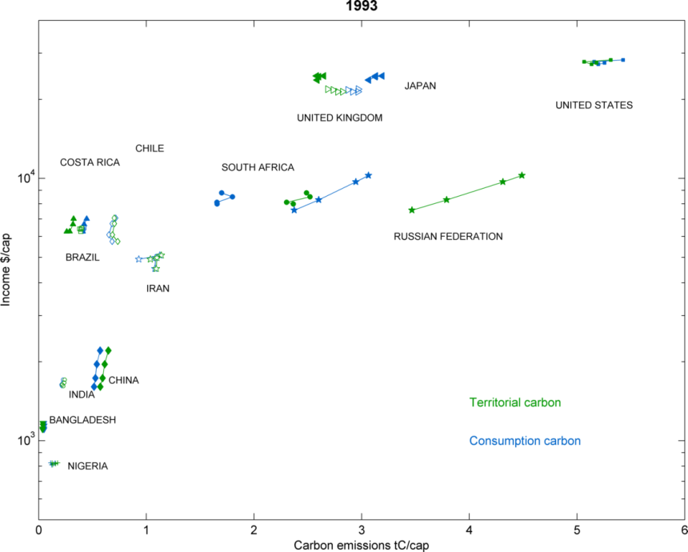
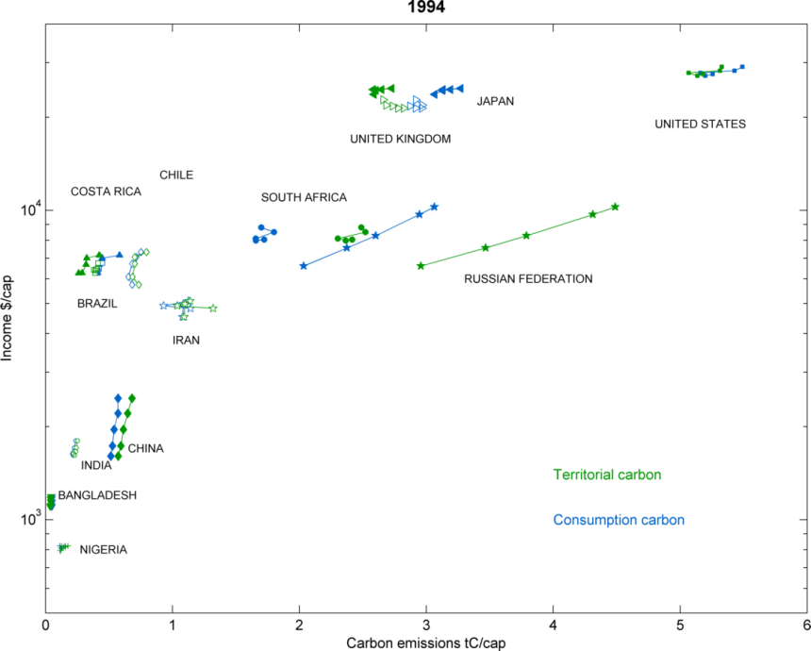
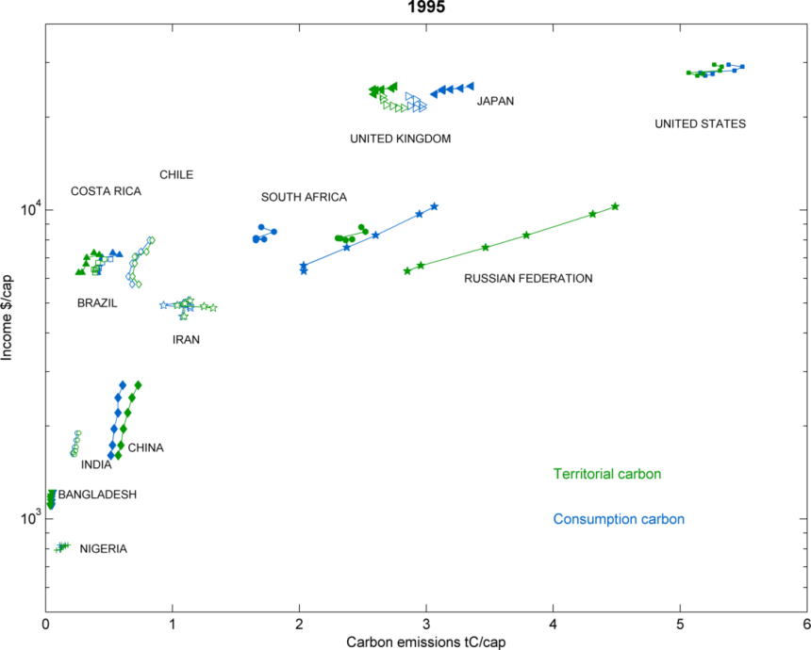
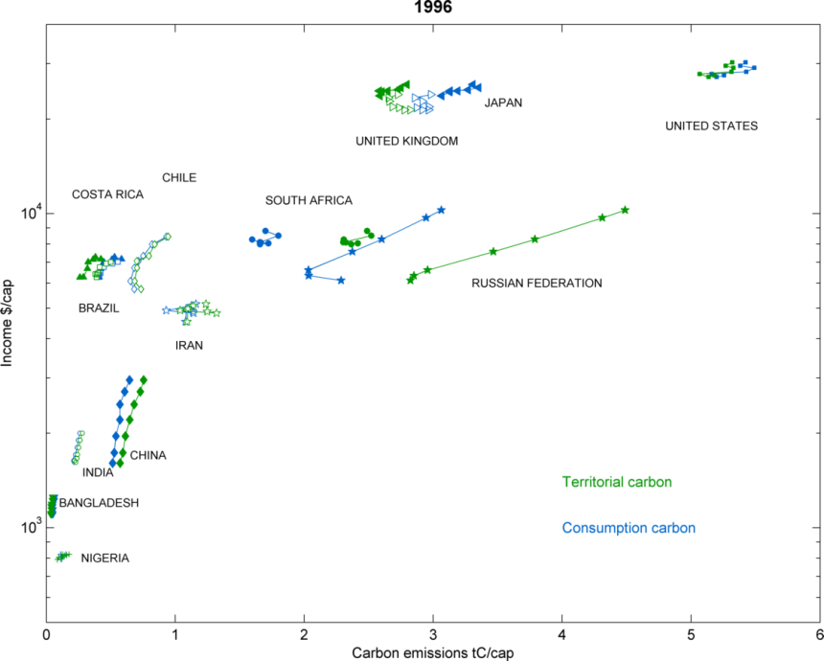
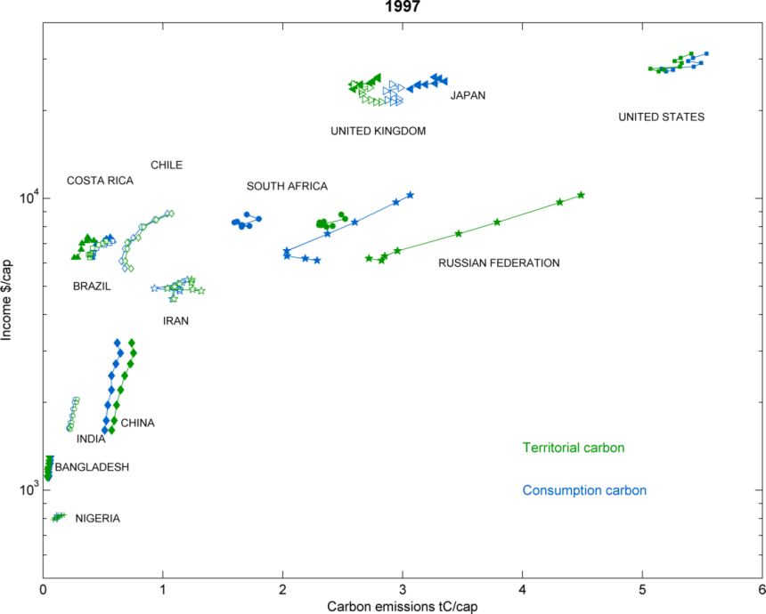
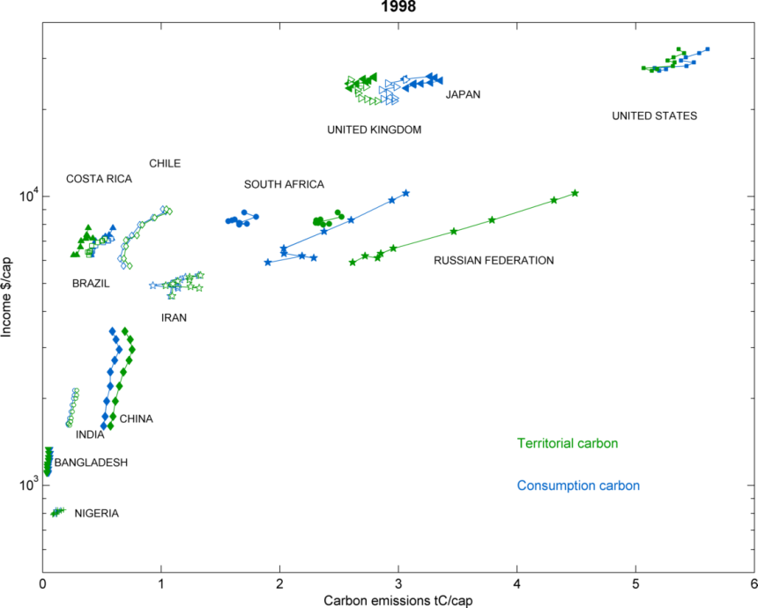
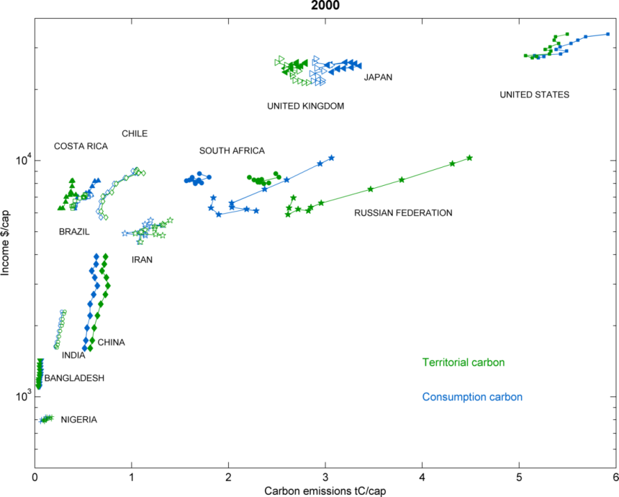
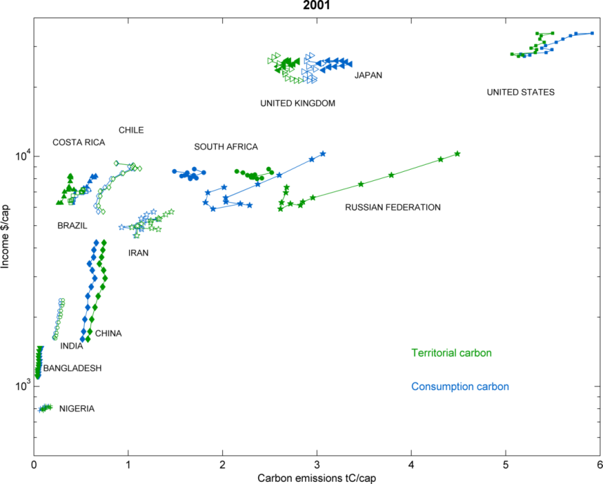
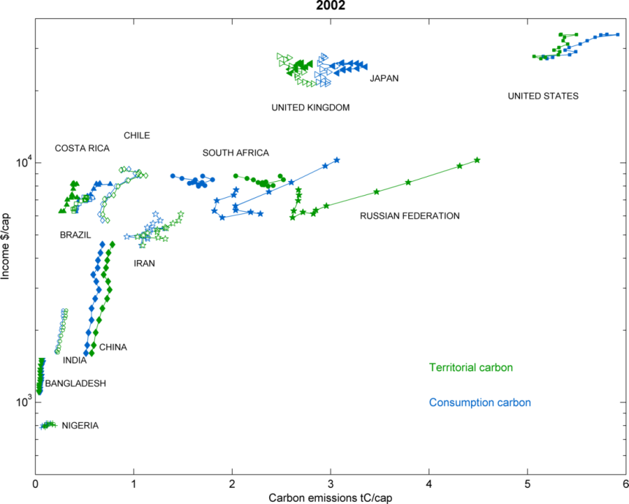
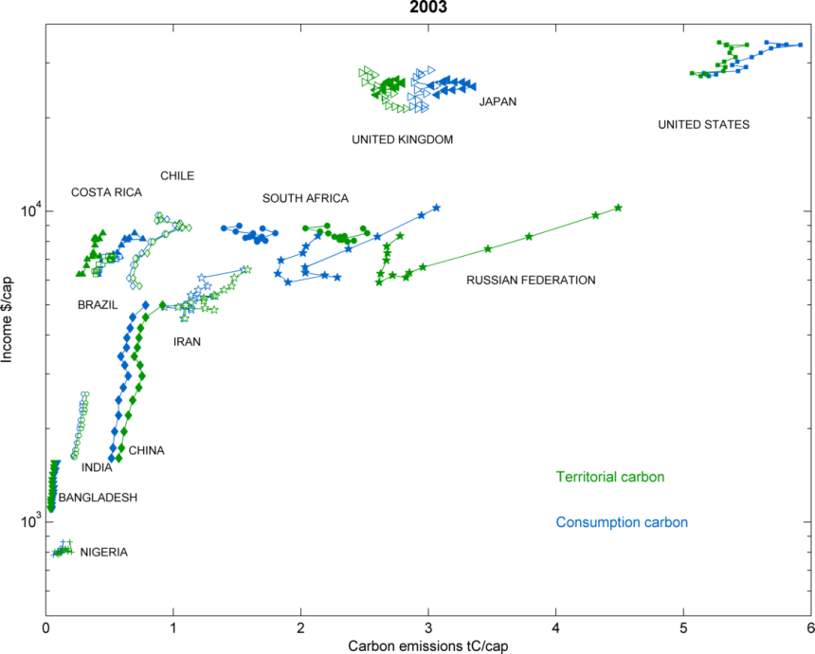
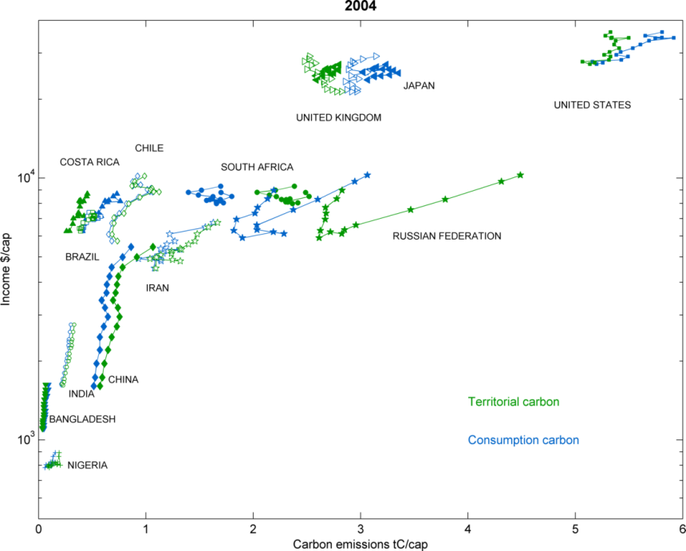
GDP ($ per capita)
Territorial emissions CO₂
Consumption-based CO₂
Carbon emissions (tonnes carbon per capita)

Slide 15
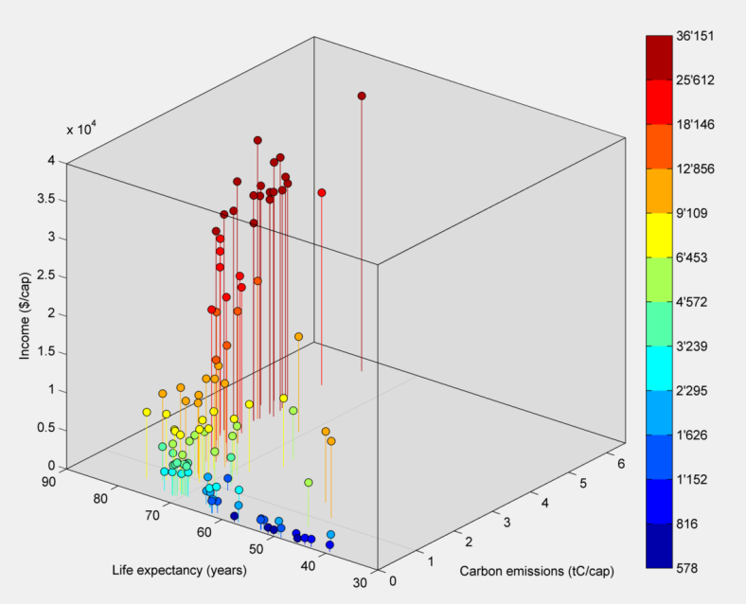
All together now: Life expectancy, income and consumption-based carbon
$/cap
Steinberger, Roberts & Peters 2011

Slide 16
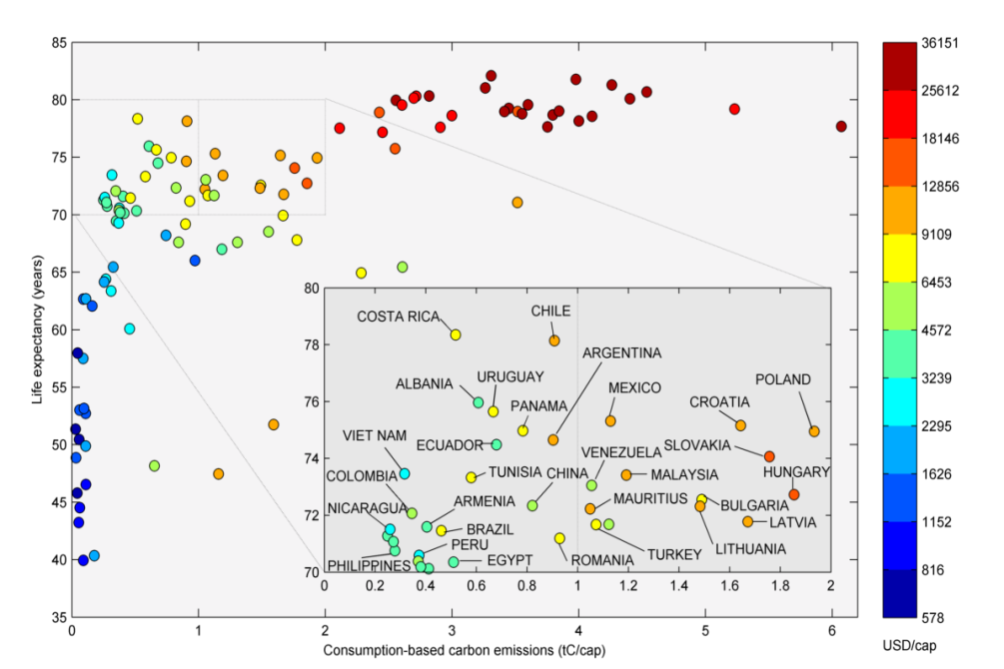
Who is sustainable?
UK
Steinberger, Roberts & Peters 2011
Brazil
China
USA
0.6tC/cap
C&C 2050 level
Life expectancy (years)
India
Nigeria
Consumption-based carbon emissions (tonnes carbon per capita)

Slide 17
Thank you for your attention
References
Steinberger, J. K. and J. T. Roberts (2010). "From constraint to sufficiency: the decoupling of energy and carbon from human needs, 1975-2005." Ecological Economics 70(2): 425-433.
Consumption-based data from Peters, G. P., J. C. Minx, C. L. Weber and O. Edenhofer (2011). "Growth in emission transfers via international trade from 1990 to 2008." Proceedings of the National Academy of Sciences.
Steinberger, J. K., J. T. Roberts and G. P. Peters (2011) Forthcoming (we hope).

